Slide 1
Lists
you will learn how to create a variety of lists.
Objectives
Upon completing this section, you should be able to
Create an unordered list.
Create an ordered list.
Create a defined list.
Nest Lists.

Slide 2
List Elements
HTML supplies several list elements. Most list elements are composed of one or more <LI> (List Item) elements.
UL : Unordered List. Items in this list start with a list mark such as a bullet. Browsers will usually change the list mark in nested lists.
<UL>
<LI> List item …</LI>
<LI> List item …</LI>
</UL>
List item …
List item …

Slide 3
List Elements
You have the choice of three bullet types: disc(default), circle, square.
These are controlled in Netscape Navigator by the “TYPE” attribute for the <UL> element.
<UL TYPE=“square”>
<LI> List item …</LI>
<LI> List item …</LI>
<LI> List item …</LI>
</UL>
List item …
List item …
List item …

Slide 4
List Elements
OL: Ordered List. Items in this list are numbered automatically by the browser.
<OL>
<LI> List item …</LI>
<LI> List item …</LI>
<LI> List item …</LI>
</OL>
List item …
List item …
List item
You have the choice of setting the TYPE Attribute to one of five numbering styles.

Slide 5
List Elements
TYPE | Numbering | Styles
1 | Arabic numbers | 1,2,3, ……
a | Lower alpha | a, b, c, ……
A | Upper alpha | A, B, C, ……
i | Lower roman | i, ii, iii, ……
I | Upper roman | I, II, III, ……

Slide 6
List Elements
You can specify a starting number for an ordered list.
<OL TYPE =“i”>
<LI> List item …</LI>
<LI> List item …</LI>
</OL>
<P> text ….</P>
<OL TYPE=“i” START=“3”>
<LI> List item …</LI>
</OL>

Slide 7
List Elements
List item …
List item …
Text ….
List item …

Slide 8
List Elements
DL: Definition List. This kind of list is different from the others. Each item in a DL consists of one or more Definition Terms (DT elements), followed by one or more Definition Description (DD elements).
<DL>
<DT> HTML </DT>
<DD> Hyper Text Markup Language </DD>
<DT> DOG </DT>
<DD> A human’s best friend!</DD>
</DL>
HTML
Hyper Text Markup Language
DOG
A human’s best friend!

Slide 9
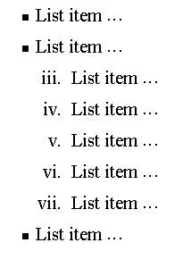
Nesting Lists
You can nest lists by inserting a UL, OL, etc., inside a list item (LI).
EXample
<UL TYPE = “square”>
<LI> List item …</LI>
<LI> List item …
<OL TYPE=“i” START=“3”>
<LI> List item …</LI>
<LI> List item …</LI>
<LI> List item …</LI>
<LI> List item …</LI>
<LI> List item …</LI>
</OL>
</LI>
<LI> List item …</LI>
</UL>

Slide 10
What will be the output?
<H1 ALIGN="CENTER">SAFETY TIPS FOR CANOEISTS</H1>
<OL TYPE=“a” START=“2”>
<LI>Be able to swim </LI>
<LI>Wear a life jacket at all times </LI>
<LI>Don't stand up or move around. If canoe tips,
  <UL>
  <LI>Hang on to the canoe </LI>
  <LI>Use the canoe for support and </LI>
  <LI>Swim to shore
  </UL> </LI>
<LI>Don't overexert yourself </LI>
<LI>Use a bow light at night </LI>
</OL>

Slide 11
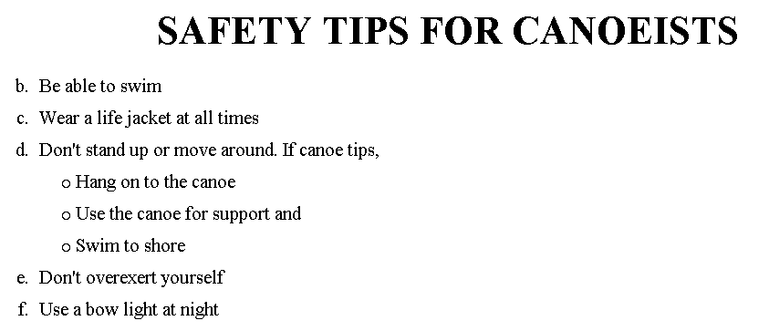
The output….

Slide 12
<H1 ALIGN="CENTER">SAFETY TIPS FOR CANOEISTS</H1>
<OL TYPE="a" START="2">
<LI>Be able to swim </LI>
<LI>Wear a life jacket at all times </LI>
<LI>Don't stand up or move around. If canoe tips,
<UL>
<LI>Hang on to the canoe </LI>
<LI>Use the canoe for support
<OL type="I" start="4">
<LI> Be careful </LI>
<LI> Do not look around</LI>
</LI> </OL>
<LI>Swim to shore
</UL> </LI>
<LI>Don't overexert yourself </LI>
<LI>Use a bow light at night </LI>
</OL>
What
will
be the
output?

Slide 13
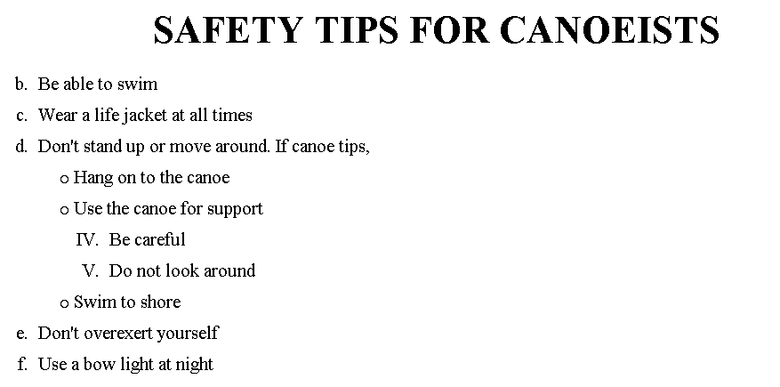
The output….

Slide 14
Images
you will learn about images and how to place images in your pages.
Objectives
Upon completing this section, you should be able to
Add images to your pages.

Slide 15
Images
<IMG>This element defines a graphic image on the page.
Image File (SRC:source): This value will be a URL (location of the image) E.g. http://www.domain.com/dir/file.ext or /dir/file.txt.
Alternate Text (ALT): This is a text field that describes an image or acts as a label. It is displayed when they position the cursor over a graphic image.
Alignment (ALIGN): This allows you to align the image on your page.
<IMG SRC=“jordan.gif“ border=4>

Slide 16
Images
Width (WIDTH): is the width of the image in pixels.
Height (HEIGHT): is the height of the image in pixels.
Border (BORDER): is for a border around the image, specified in pixels.
HSPACE: is for Horizontal Space on both sides of the image specified in pixels. A setting of 5 will put 5 pixels of invisible space on both sides of the image.
VSPACE: is for Vertical Space on top and bottom of the image specified in pixels. A setting of 5 will put 5 pixels of invisible space above and bellow the image.

Slide 17
Some Examples on images
1) <IMG SRC=“jordan.gif“ border=4>
2) <IMG SRC=" jordan.gif" width="60" height="60">
3) <IMG SRC=“jordan.gif" ALT="This is a text that goes with the image">
4) <IMG SRC=" jordan.gif “ Hspace="30" Vspace="10" border=20>
5) < IMG SRC =" jordan.gif“ align="left">
blast blast blast blast blast

Slide 18
Anchors, URLs and Image Maps
you will learn about Uniform Resource Locator, and how to add them as Anchor or Links inside your web pages.
Objectives
Upon completing this section, you should be able to
Insert links into documents.
Define Link Types.
Define URL.
List some commonly used URLs.
Plan an Image Map.

Slide 19
HOW TO MAKE A LINK
1) The tags used to produce links are the <A>
and </A>. The <A> tells where the link should start and
the </A> indicates where the link ends. Everything between
these two will work as a link.
2) The example below shows how to make the word
Here work as a link to yahoo.
Click <A HREF="http://www.yahoo.com">here</A> to
go to yahoo.

Slide 20
E-Mail (Electronic Mail)
E.g. mailto:kmf@yahoo.com
The type of service is identified as the mail client program. This type of link will launch the users mail client.
The recipient of the message is kmf@yahoo.com
<A HREF=“mailto:kmf@yahoo.com”>Send me
More Information </A>

Slide 21
Tables
you will learn that tables have many uses in
HTML.
Objectives:
Upon completing this section, you should be able to:
Insert a table.
Explain a table’s attributes.
Edit a table.
Add a table header.

Slide 22
Tables
The <TABLE></TABLE> element has four sub-elements:
Table Row<TR></TR>.
Table Header <TH></TH>.
Table Data <TD></TD>.
Caption <CAPTION></CAPTION>.
The table row elements usually contain table header elements or table data elements.

Slide 23
Tables
<table border=“1”>
<tr>
<th> Column 1 header </th>
<th> Column 2 header </th>
</tr>
<tr>
<td> Row1, Col1 </td>
<td> Row1, Col2 </td>
</tr>
<tr>
<td> Row2, Col1 </td>
<td> Row2, Col2 </td>
</tr>
</table>

Slide 24
Tables
Column 1 Header | Column 2 Header
Row1, Col1 | Row1, Col2
Row2, Col1 | Row2, Col2

Slide 25
Tables Attributes
BGColor: Some browsers support background colors in a table.
Width: you can specify the table width as an absolute number of pixels or a percentage of the document width. You can set the width for the table cells as well.
Border: You can choose a numerical value for the border width, which specifies the border in pixels.
CellSpacing: Cell Spacing represents the space between cells and is specified in pixels.

Slide 26
Table Attributes
CellPadding: Cell Padding is the space between the cell border and the cell contents and is specified in pixels.
Align: tables can have left, right, or center alignment.
Background: Background Image, will be titled in IE3.0 and above.
BorderColor, BorderColorDark.

Slide 27
Table Caption
A table caption allows you to specify a line of text that will appear centered above or bellow the table.
<TABLE BORDER=1 CELLPADDING=2>
<CAPTION ALIGN=“BOTTOM”> Label For My Table </CAPTION>
The Caption element has one attribute ALIGN that can be either TOP (Above the table) or BOTTOM (below the table).

Slide 28
Table Header
Table Data cells are represented by the TD element. Cells can also be TH (Table Header) elements which results in the contents of the table header cells appearing centered and in bold text.

Slide 29
Table Data and Table Header Attributes
Colspan: Specifies how many cell columns of the table this cell should span.
Rowspan: Specifies how many cell rows of the table this cell should span.
Align: cell data can have left, right, or center alignment.
Valign: cell data can have top, middle, or bottom alignment.
Width: you can specify the width as an absolute number of pixels or a percentage of the document width.
Height: You can specify the height as an absolute number of pixels or a percentage of the document height.

Slide 30
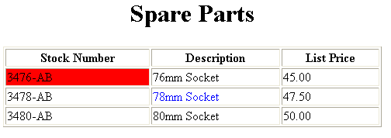
Basic Table Code
<TABLE BORDER=1 width=50%>
<CAPTION> <h1>Spare Parts <h1> </Caption>
<TR><TH>Stock Number</TH><TH>Description</TH><TH>List Price</TH></TR>
<TR><TD bgcolor=red>3476-AB</TD><TD>76mm Socket</TD><TD>45.00</TD></TR>
<TR><TD >3478-AB</TD><TD><font color=blue>78mm Socket</font> </TD><TD>47.50</TD></TR>
<TR><TD>3480-AB</TD><TD>80mm Socket</TD><TD>50.00</TD></TR>
</TABLE>

Slide 31
Table Data and Table Header Attributes
<Table border=1 cellpadding =2>
<tr> <th> Column 1 Header</th> <th> Column 2 Header</th> </tr>
<tr> <td colspan=2> Row 1 Col 1</td> </tr>
<tr> <td rowspan=2>Row 2 Col 1</td>
<td> Row 2 Col2</td> </tr>
<tr> <td> Row 3 Col2</td> </tr>
</table>

Slide 32
Table Data and Table Header Attributes
Column 1 Header | Column 2 Header
Row 1 Col 1
Row 2 Col 1 | Row 2 Col 2
 | Row 3 Col 2

Slide 33
Special Things to Note
TH, TD and TR should always have end tags.
Although the end tags are formally optional, many browsers will mess up the formatting of the table if you omit the end tags. In particular, you should always use end tags if you have a TABLE within a TABLE -- in this situation, the table parser gets hopelessly confused if you don't close your TH, TD and TR elements.
A default TABLE has no borders
By default, tables are drawn without border lines. You need the BORDER attribute to draw the lines.
By default, a table is flush with the left margin
TABLEs are plopped over on the left margin. If you want centered tables, You can either: place the table inside a DIV element with attribute ALIGN="center".
Most current browsers also supports table alignment, using the ALIGN attribute. Allowed values are "left", "right", or "center", for example: <TABLE ALIGN="left">. The values "left" and "right" float the table to the left or right of the page, with text flow allowed around the table. This is entirely equivalent to IMG alignment

Slide 34
What will be the output?
    <TABLE BORDER width=“750”>
    <TR> <TD colspan=“4” align=“center”>Page Banner</TD></TR>
    <TR> <TD rowspan=“2” width=“25%”>Nav Links</TD><TD colspan=“2”>Feature Article</TD> <TD rowspan=“2” width=“25%”>Linked Ads</TD></TR>
    <TR><TD width=“25%”>News Column 1 </TD> <TD width=“25%”><News Column 2 </TD></TR>
    </TABLE>

Slide 35
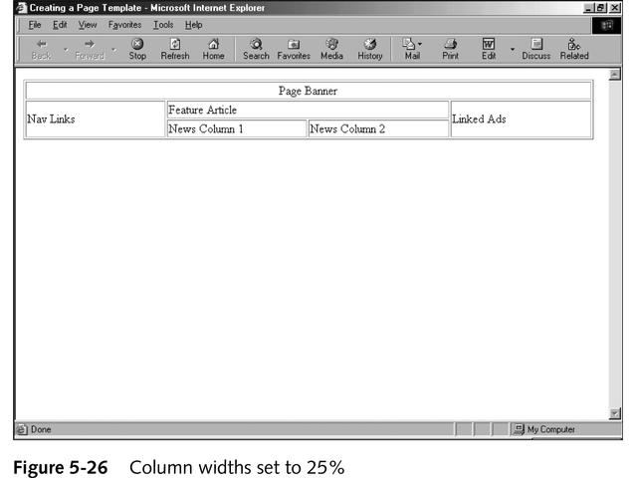
The Output

